Slide 1
ANTLR 4
(ANother Tool for Language Recognition) is a parser generator that can read, process, execute, or translate structured text or binary files. It's used to build languages, tools, and frameworks in academia and industry. For example, Twitter uses ANTLR to parse search queries.
ANTLR provides access to language processing primitives like lexers, grammars, and parsers, as well as the runtime to process text against them. From a grammar, ANTLR generates a parser that can build and walk parse trees. ANTLR uses a LL(*) algorithm for parsing.

Slide 2
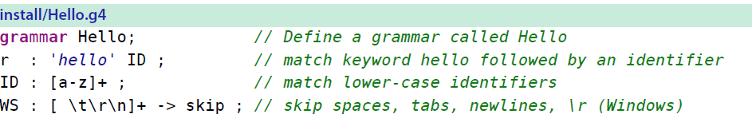
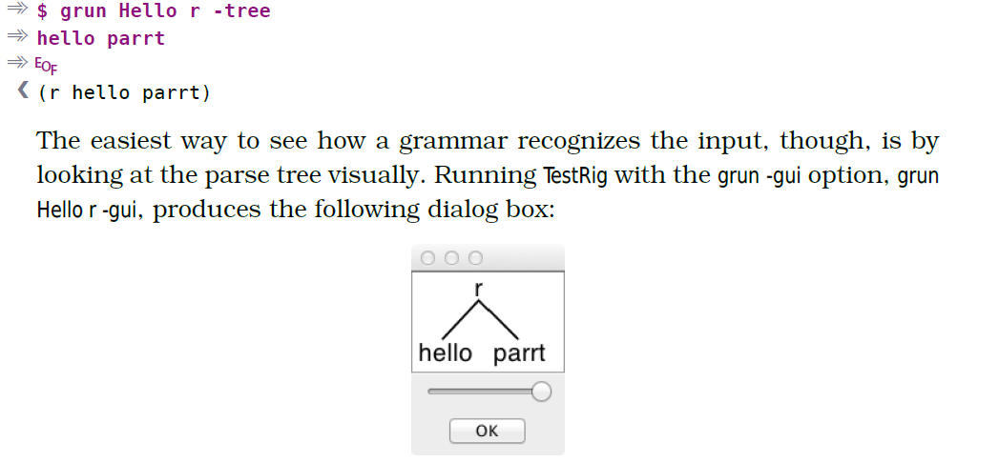

Slide 3
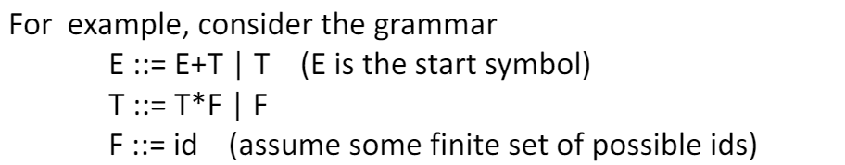
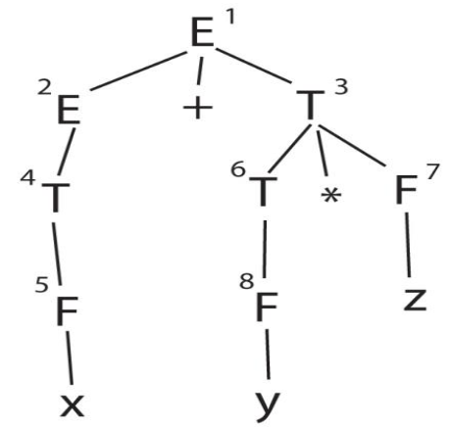
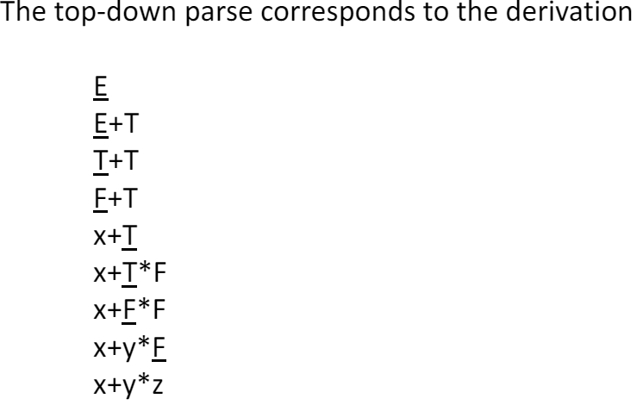
TOP DOWN PARSING (LL PARSING) Recursive Descent

Slide 4
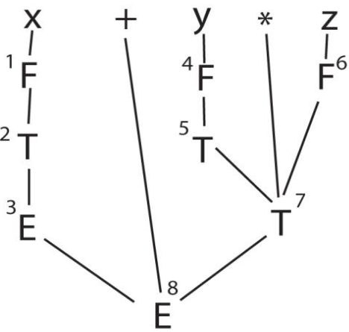
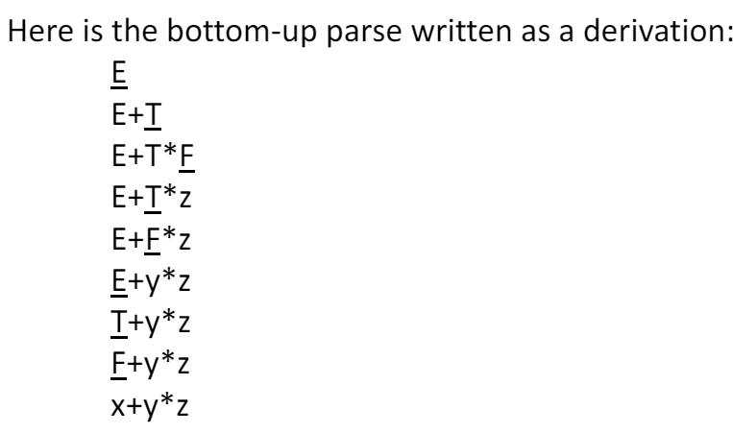
BOTTOM UP PARSING (LR PARSING)

